Slide 1
Investigate & Reframe
Parneet, Matthew, Christian and Jessie

Slide 2
Key findings & insights
Many young people are politically active, but not in traditional ways (e.g. they are protesting or taking other political actions on individual level). But many young people have a lack of faith in the political system and feel like their vote won't matter​
Young people seem to be unsure what policies are in place and whether they correlate to their needs (what issues they feel are most important). There seems to be a distinct lack of communication between the two. Its possible politicians are pandering to older demographic as they know they have higher voter turnout​.
This is not a new problem. This suggests all previous solutions haven't understood what the real problem is. Voter rates are also low for 25-29-year olds. Maybe young people needs to be extended to under 30’s?

Slide 3
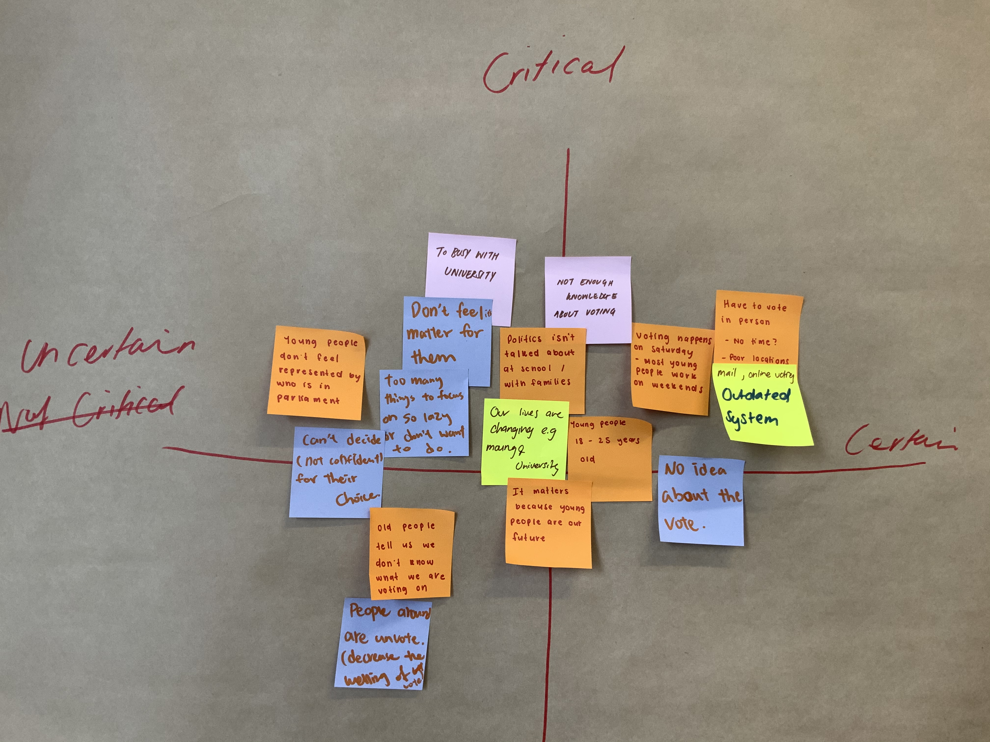
Assumption Maps
In week 2 we mapped our assumptions on why young people don’t vote. We started by writing assumptions on post-it note without judgement, and then mapped them on a grid from uncertain – certain and critical – uncritical. We completed this activity before we formed our final group, which enabled us to gather ideas from other students in the class before coming together to compare and contrast our assumptions with our final group.

Slide 4
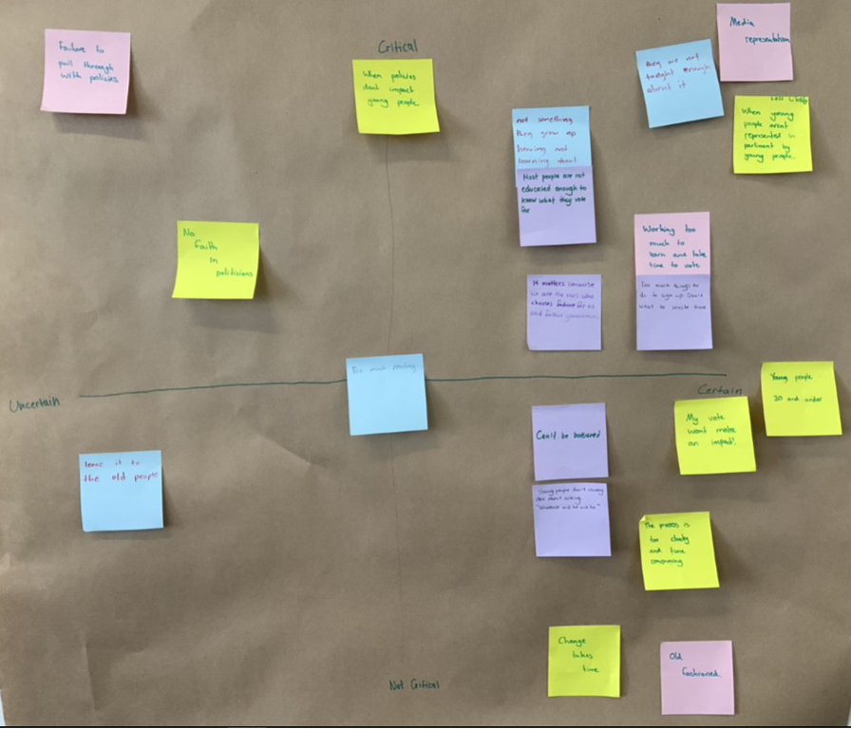
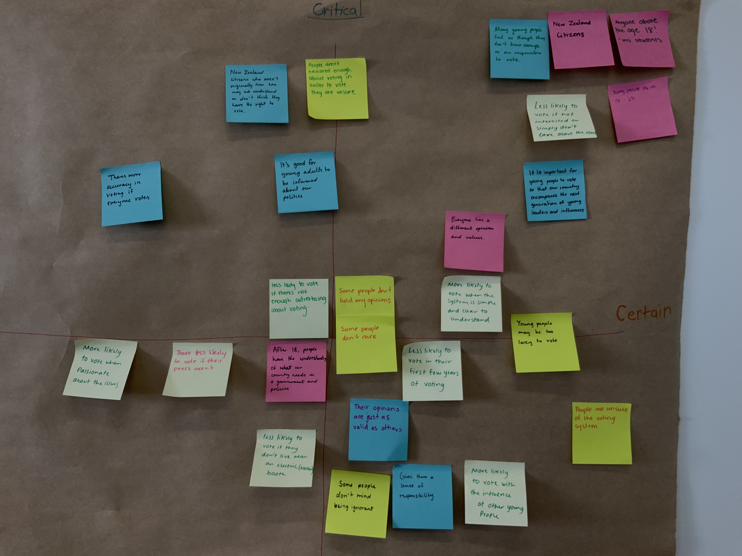

Slide 5
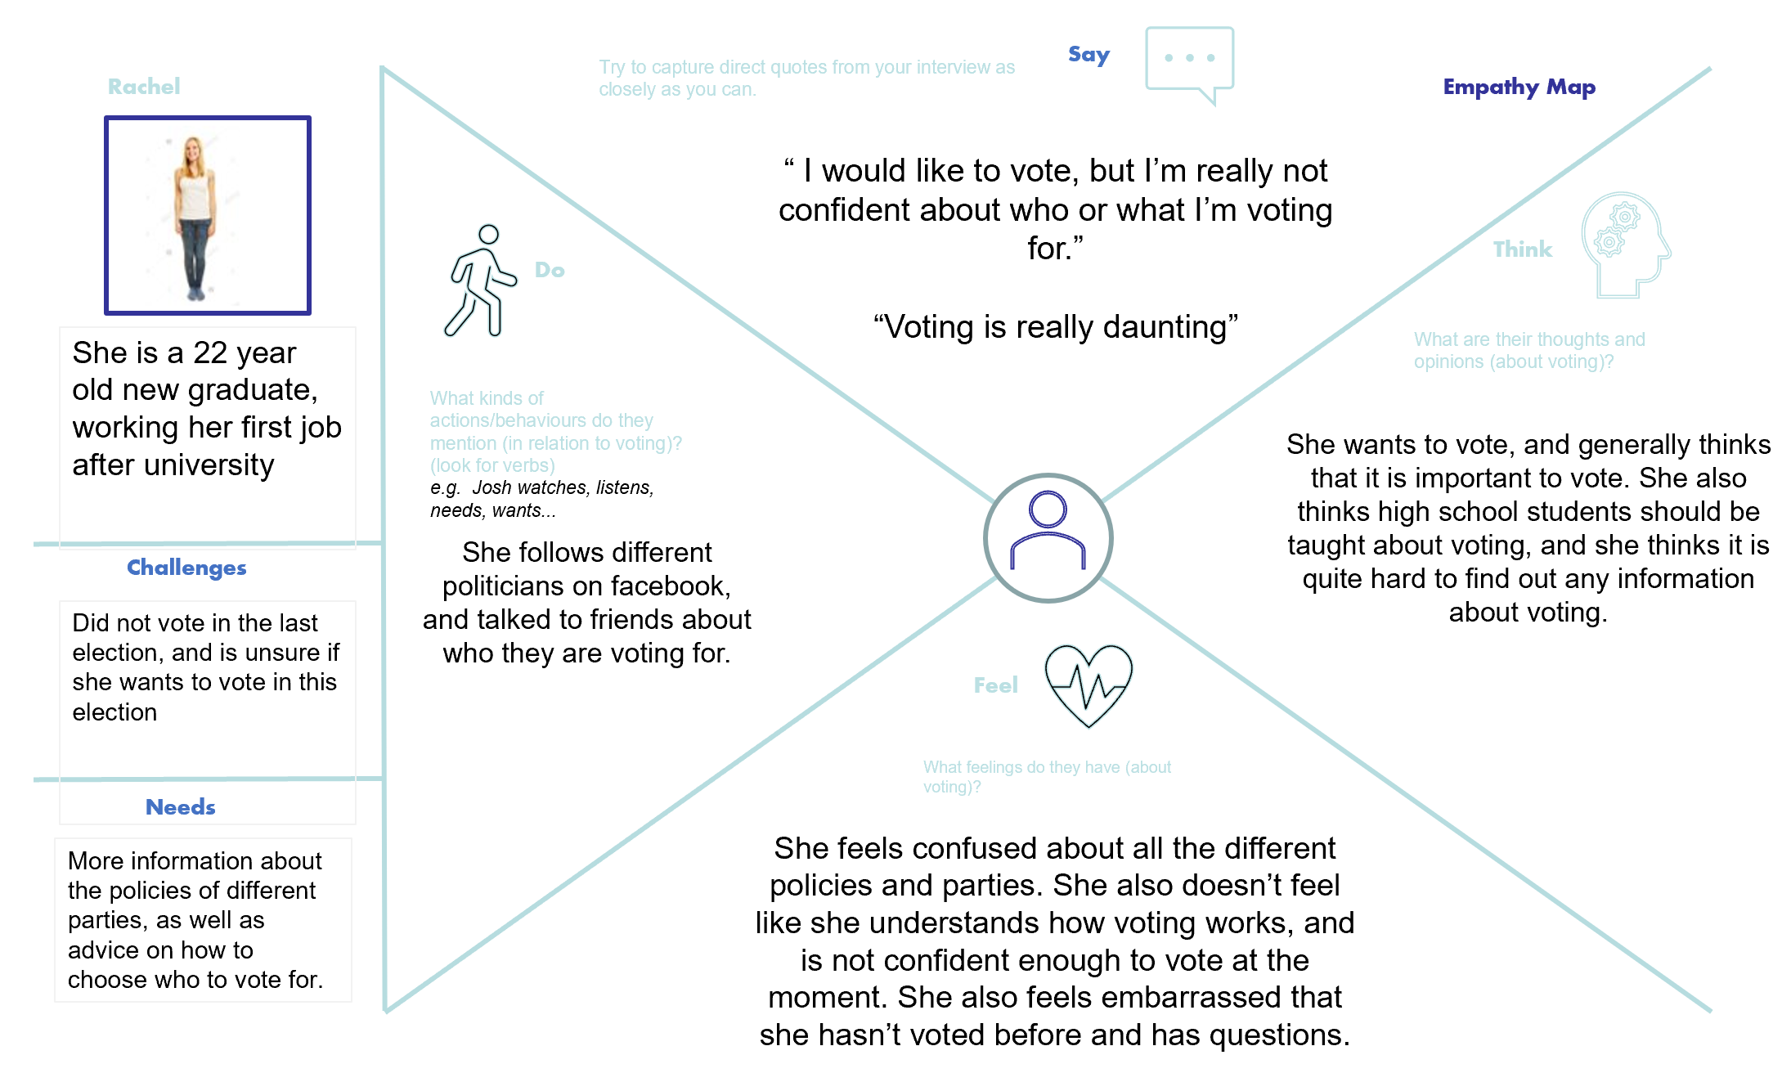
Empathy Maps
In week 4 we developed empathy maps based on interviews we had done. We broke down the information we gathered in the interviews so we could better understand our interviewees views on voting.

Slide 6
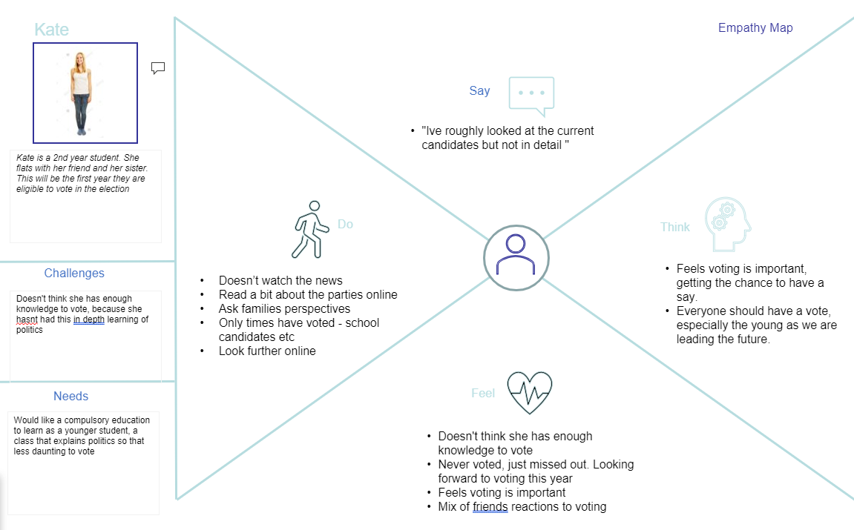
Empathy Maps

Slide 7
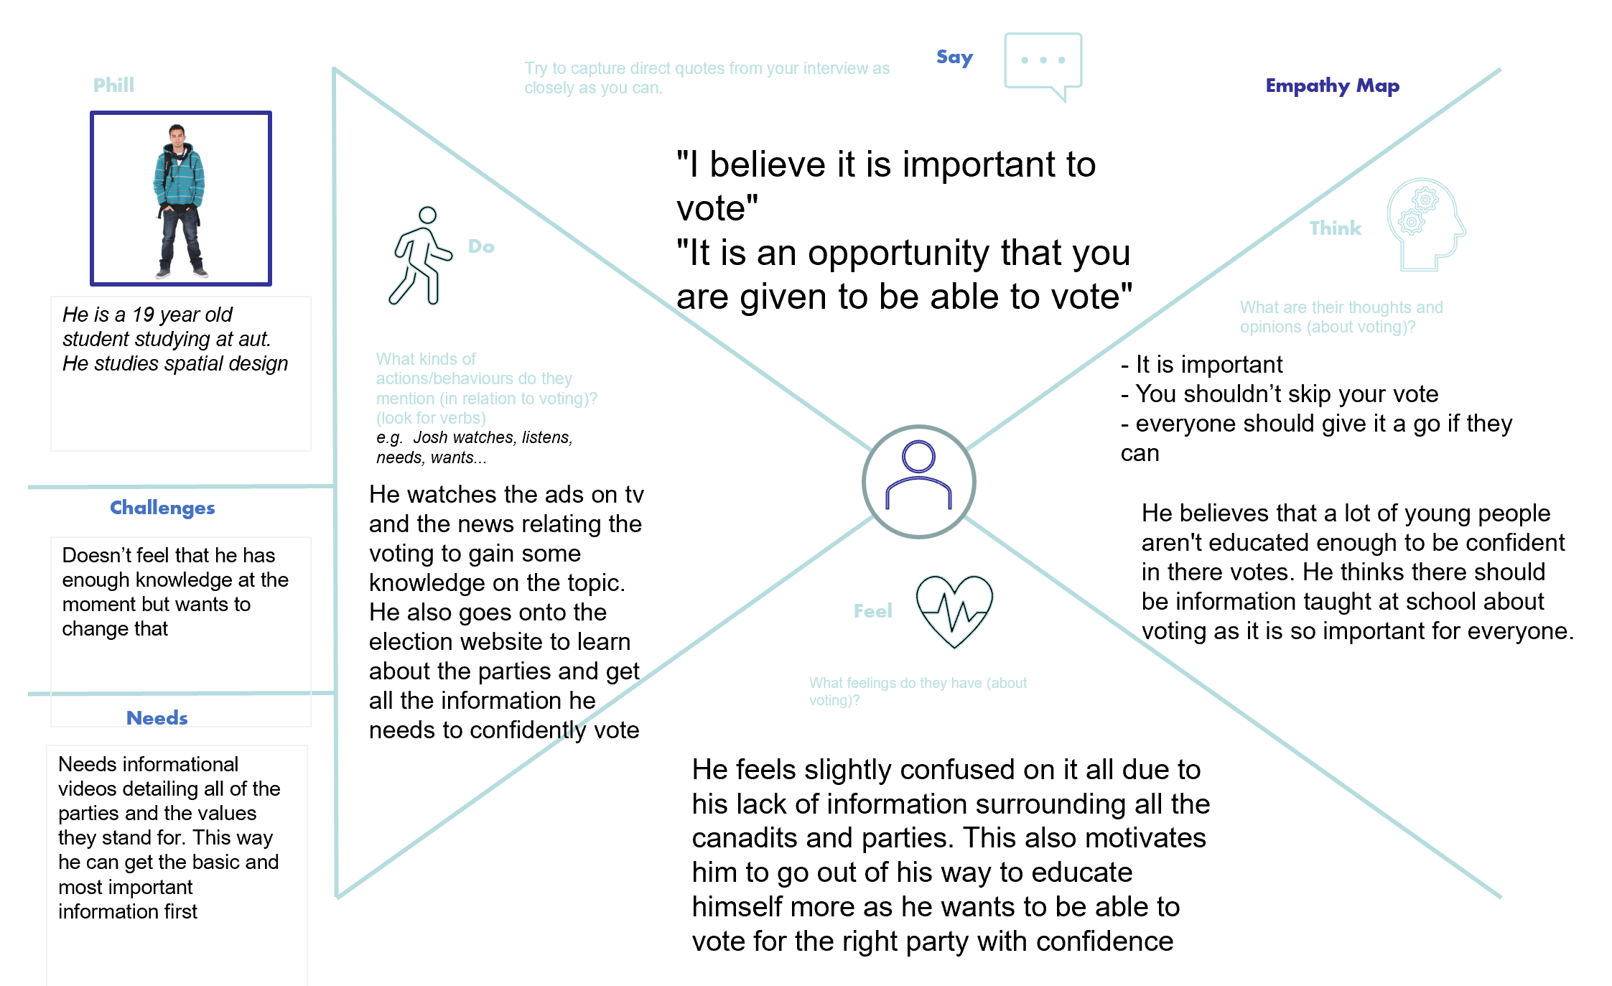
Empathy Maps

Slide 8
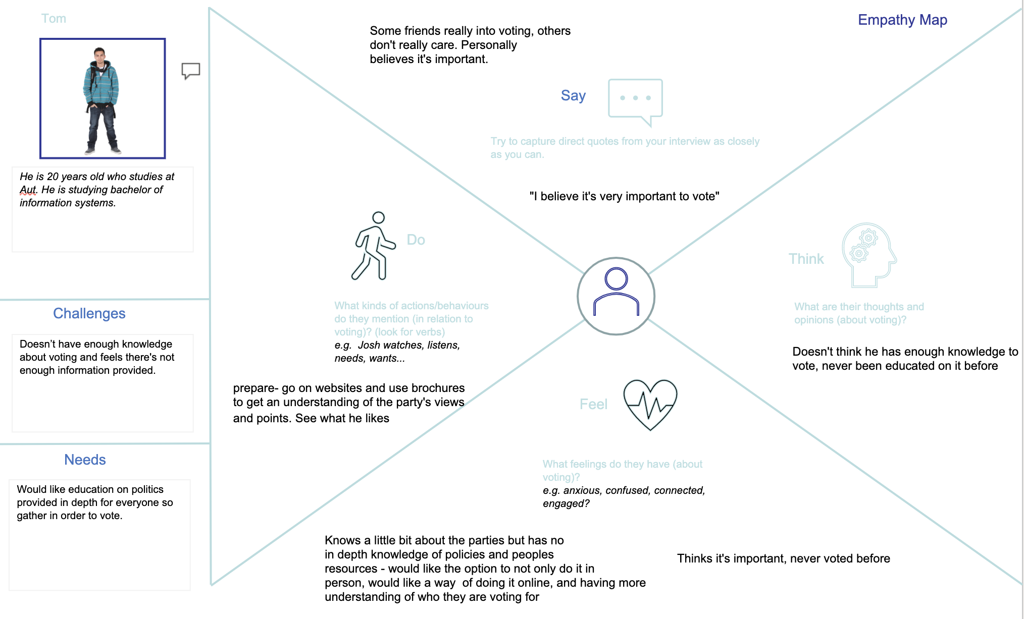
Empathy Maps

Slide 9
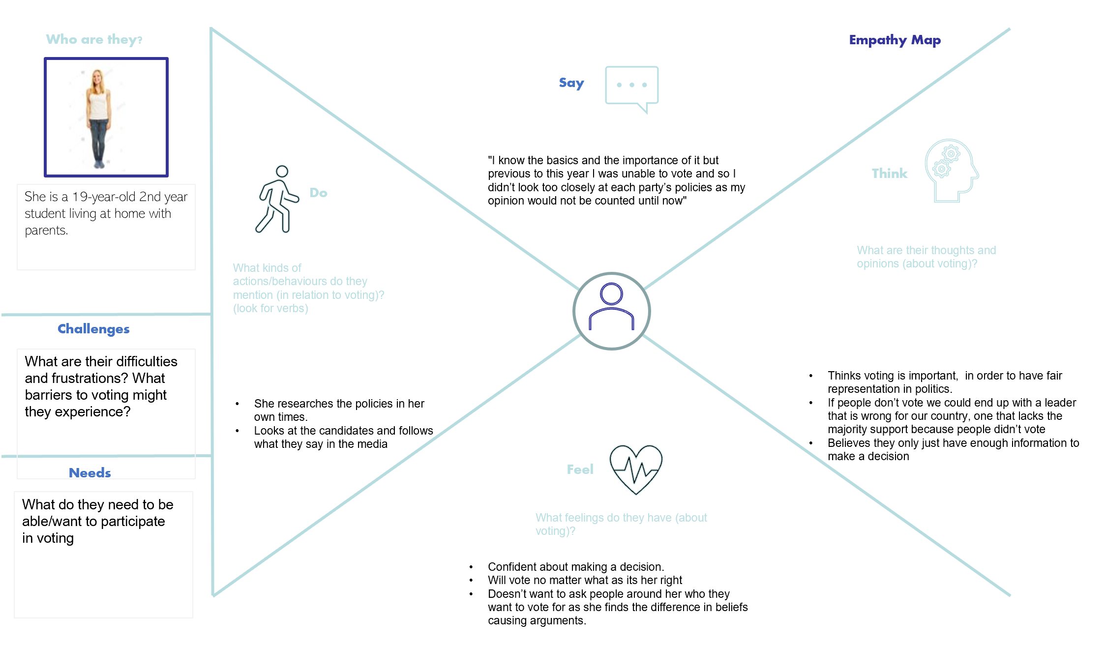
Empathy Maps

Slide 10
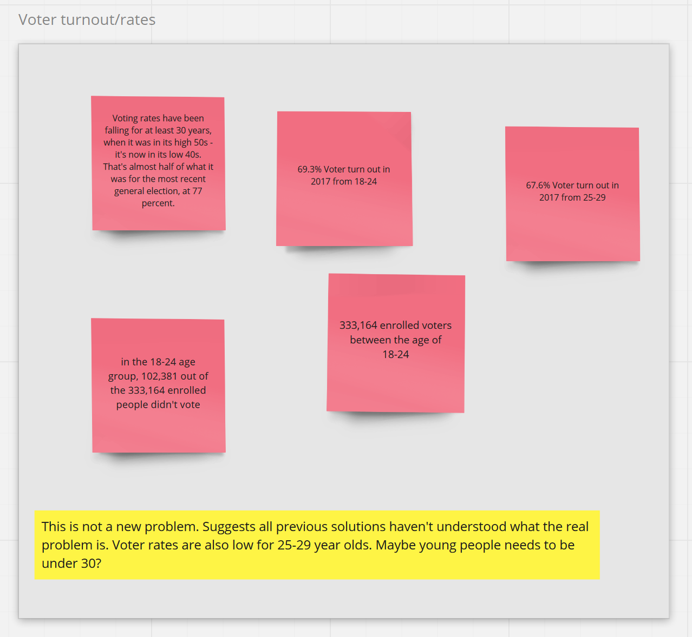
Miro Board
In week 6 we collated all the information we had gathered so far and collated them into themes. This information was collected from our own assumptions, relevant information found while knowledge gathering, as well as observations from our interviews. After finding themes between our information, we were then able to develop insights referring to the themes.

Slide 11
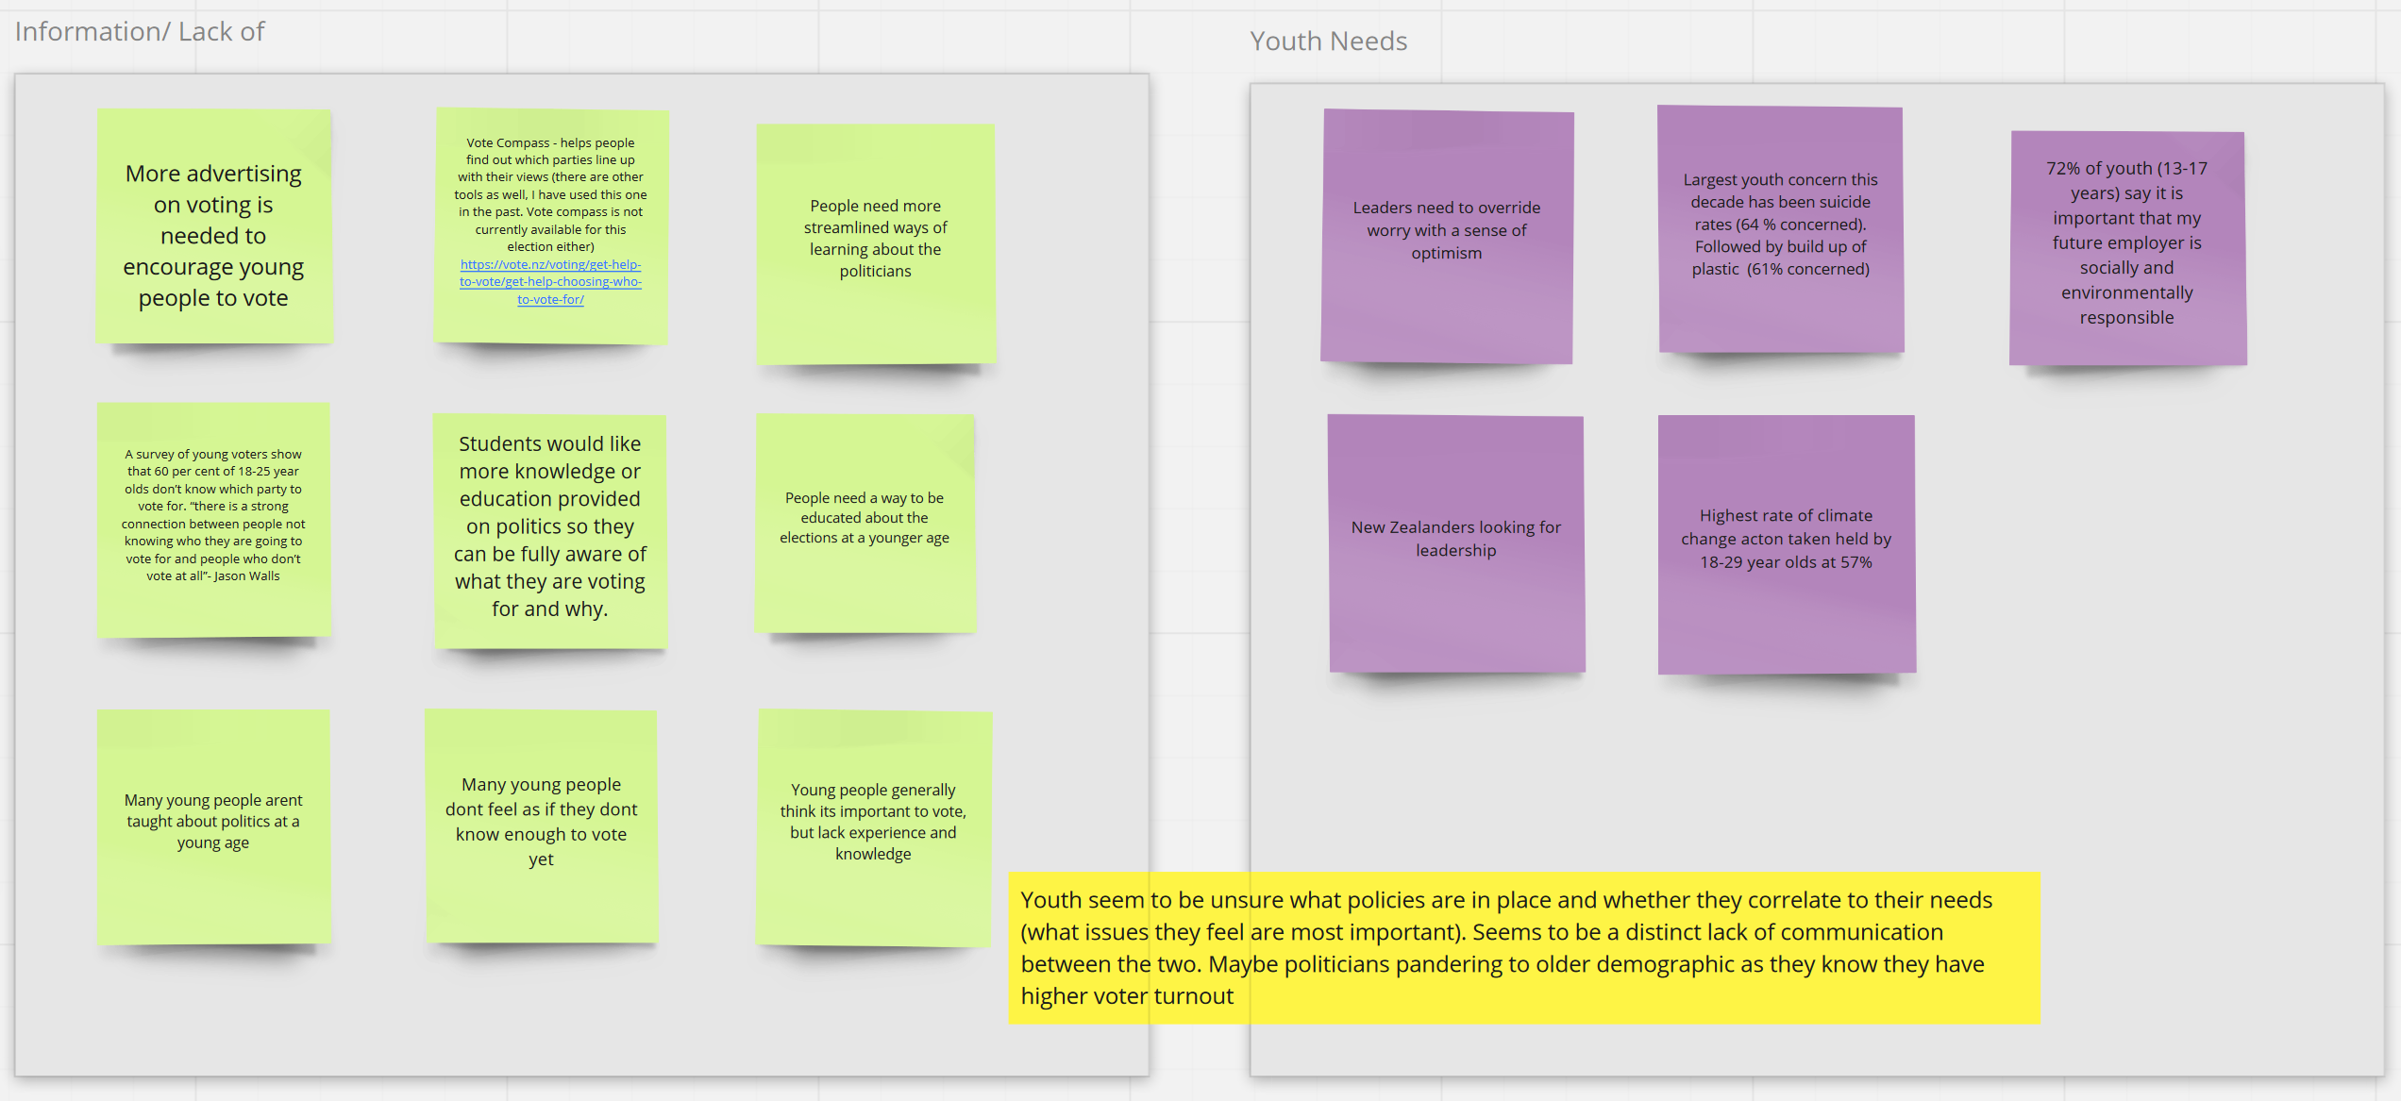
Miro Board

Slide 12
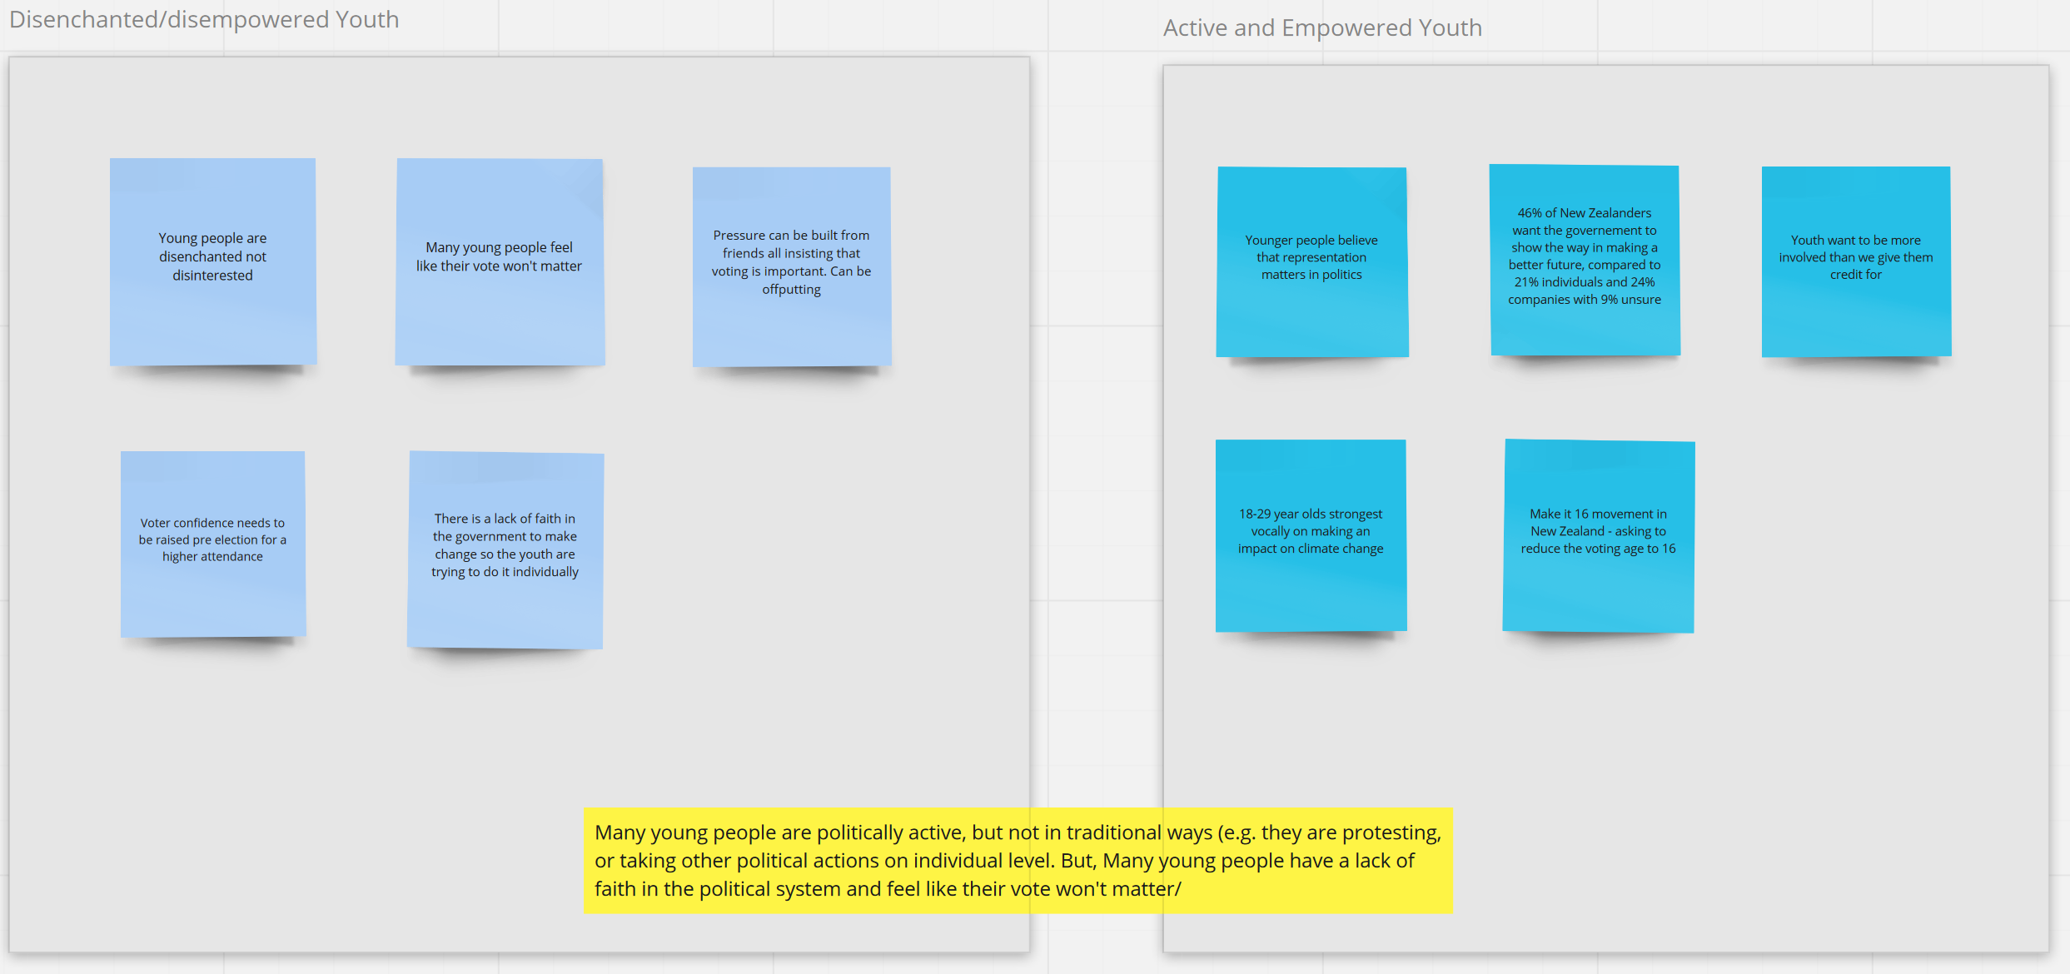
Miro Board

Slide 13
Persona
Johnny is an 18-year-old male who lives in Auckland Central, and is a full-time student. He is in his first year at AUT studying design, and balances part time work with full time study. This year will be the first time Johnny will be eligible to vote in the general election.
Johnny values good health care and education alongside equality of gender. He also cares about his friends/family, helping people and likes to try new things.​ Overall, Johnny wants to learn more about politics as he wants to gain a better understanding of who he is voting for. He knows what he would like to vote for but is unsure how to match his personal beliefs with the policies of different parties.
From this we can determine that Johnny needs more education provided around the political parties to decide who to vote for. He also needs to feel confident that his vote with matter.
Notes:
1. Persona Name: Johnny​
2. Gender/Age: Male/18​
4. Place of residency: Auckland Central​
5. Occupation: Full-time Student​
6. What is their situation?​
Johnny is an 18yr old first year Design student at AUT. He currently attends UNI full time
and works part time. This will be his first year of voting in the general elections.​
7. What are the things they care about/value?​
Johnny values good health care and education alongside equality of gender. He cares
about his friends/family, helping people and likes to try new things.​
8. What are their goals?​
Johnny wants to learn more about politics in order to gain a good understanding of who he
will vote for. ​
9. What are their unmet needs?​
Johnny needs more education provided around the political parties to decide who to vote
for.

Slide 14
Point of View Statement
Persona
Unmet Needs
Insights
Johnny is an 18yr old first year Design student at AUT. He currently attends university full time and works part time. This will be his first year of voting in the general elections.
Needs to be able to connect with who he will be voting for and feel included and valued.
Youth seem to be unsure what policies are in place and whether they correlate to their needs and have a lack of faith in the political system due to feeling like their vote won't matter.
Needs
Because

Slide 15
Opportunity Statement
There is an opportunity to help first time voters (18-29) to feel more confident that their vote will make an impact because young people may have a lack of faith in the political system and can feel like their vote won’t matter.

Slide 16
Reflection
As a team we have learnt how to communicate our insights and ideas towards the design brief through visualization activities and design plans. These activities have increased our confidence in insight generation and have offered us ways to describe our information through different tools and methods e.g. empathy maps and post it notes in order for the entire group to have a solid understanding of our insights.
Through this challenge we've learnt about the different circumstances’ youth in NZ face regarding elections and has a deep impact on us personally, since for many of us and our peers this will be our first-time voting. ​
Our team efforts have produced what we feel is a high standard of work in an environment which is accommodating to each group member.

Slide 17
Thanks!

